Slide 1



Pediatric Clinical System

Slide 2

Table of contents
01
02
Introduction
Literature review
03
Methodology
05
Results and discussion
06
07
Conclusion
References

Slide 3




Introduction
Challenges in pediatric healthcare management.
Need for a transformative solution: Integrated Pediatric Clinic System with Incubation System.
Key features: Electronic medical records, online appointment scheduling, electronic prescription management, decision support tools, registration and payment management, integration with incubation system, reporting and analytics, security and compliance.

Slide 4
Literature Review
Study 1: "Improving Pediatric Clinic Efficiency through Integration with an Incubation System" (Anderson et al., 2019)
Benefits: Improved sample tracking, streamlined administrative tasks, increased clinic efficiency
Importance of user-friendly system and efficient data management

Slide 5


Literature Review
Study 2: "Enhancing Patient Care through Integrated Pediatric Clinic and Incubation Systems" (Miller & Davis, 2020)
Benefits: Accurate diagnoses, timely treatment decisions, streamlined processes, enhanced patient experience
Need for secure and centralized data management

Slide 6

Literature Review
Study 3: "Optimizing Incubation Operations in Pediatric Clinics" (Gonzalezet al., 2021) Benefits: Improved sample tracking, reduced errors, real-time monitoring, improved patient care Importance of scalability and reliability

Slide 7
Methodology
Steps in the development of the Pediatric clinic system
Requirements analysis, design phase, development, integration and testing, database management.
Html, css, js, php, vs code, fire base.

Slide 8

Results and Discussion
Improved patient care: Electronic medical records, appointment scheduling, electronic prescription management, real-time reporting and analytics.
Streamlined operations: Automated administrative tasks, improved sample tracking, centralized database.
Enhanced data management: Compliance with regulations, secure data storage.
Increased staff efficiency: Quick access to patient data, mobile access.
Implications: Improved patient satisfaction, enhanced clinical decision-making, cost savings, compliance and data security.

Slide 9
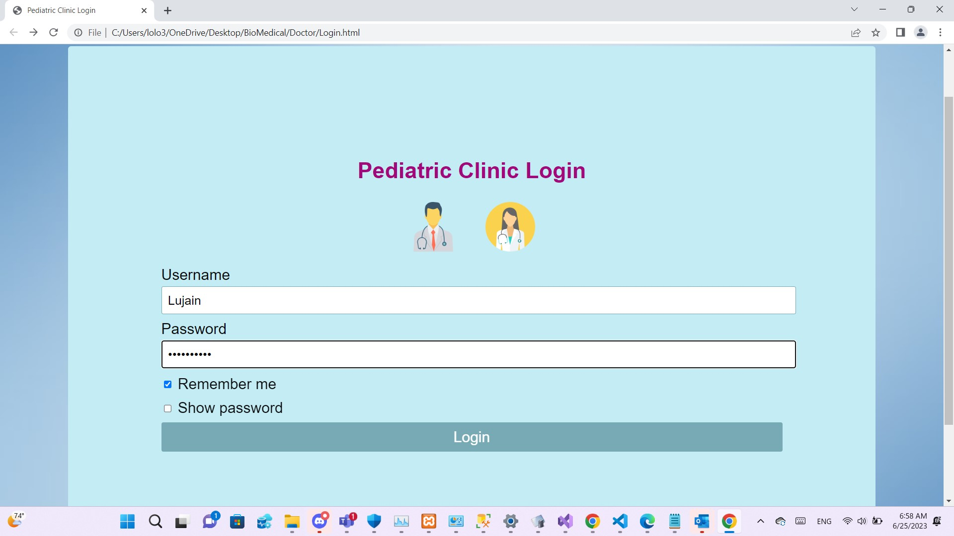
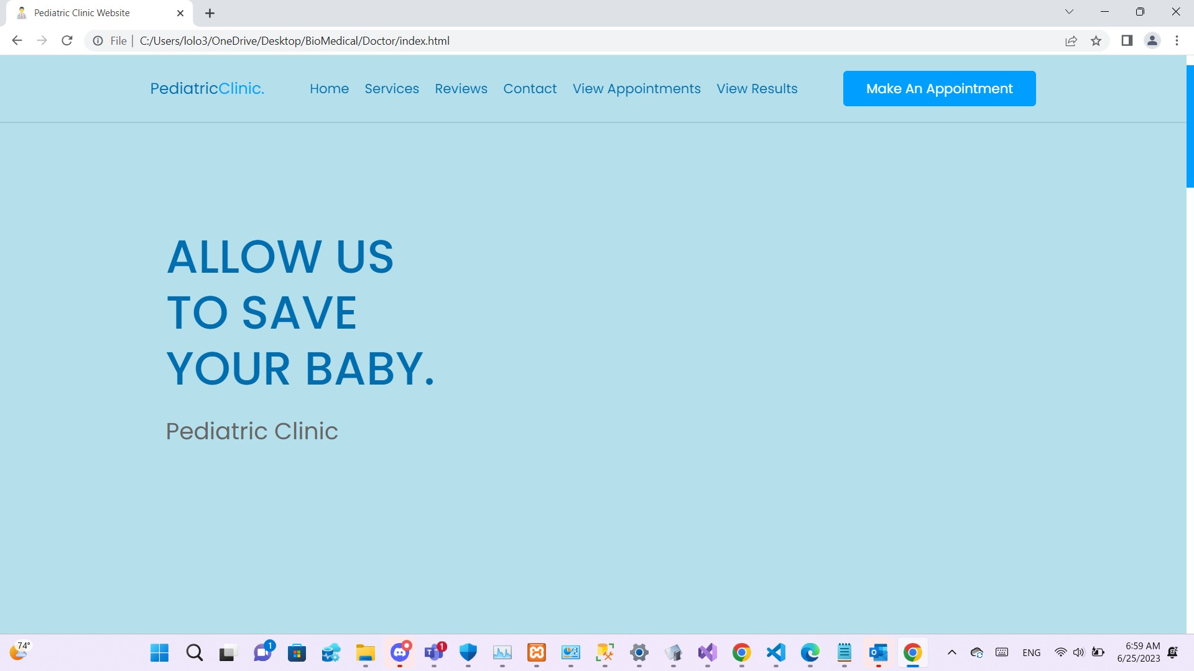
Pediatric Clinical System

Slide 10
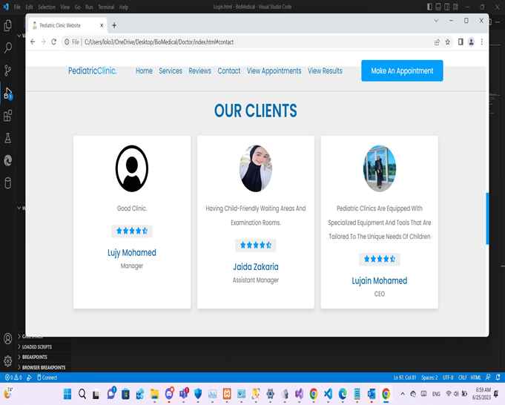
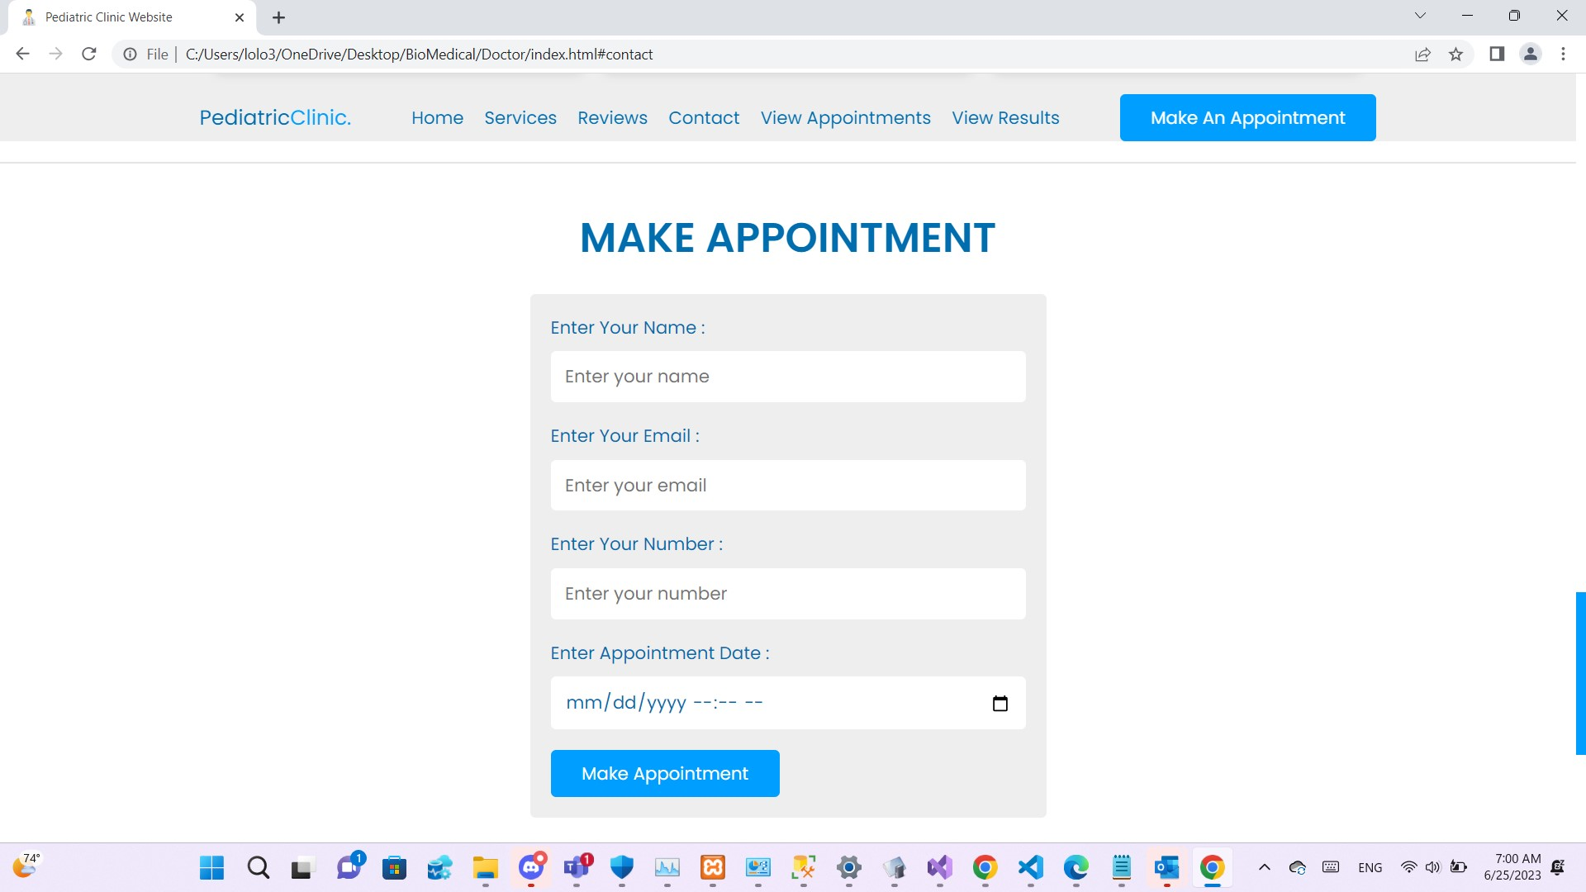
Pediatric Clinical System

Slide 11
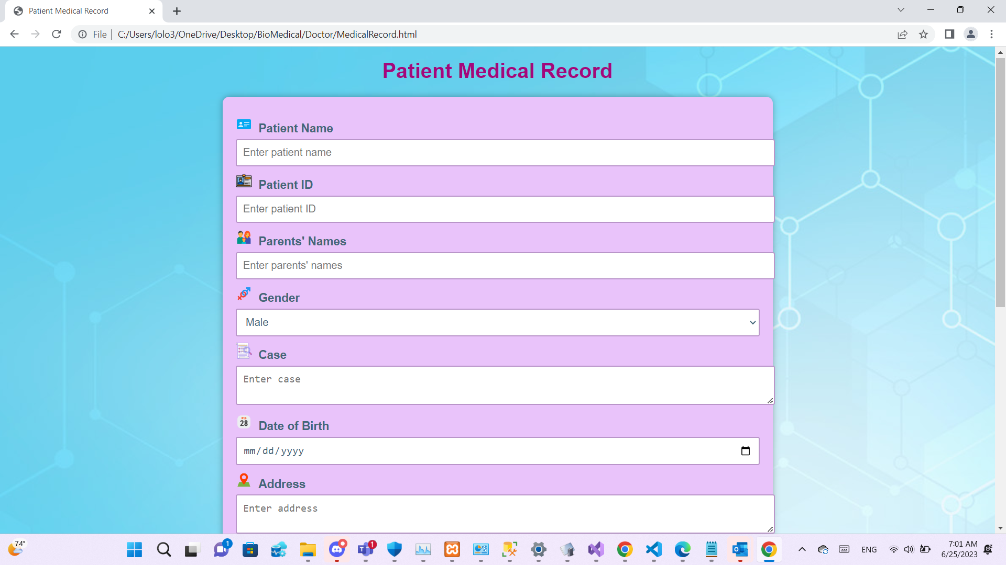
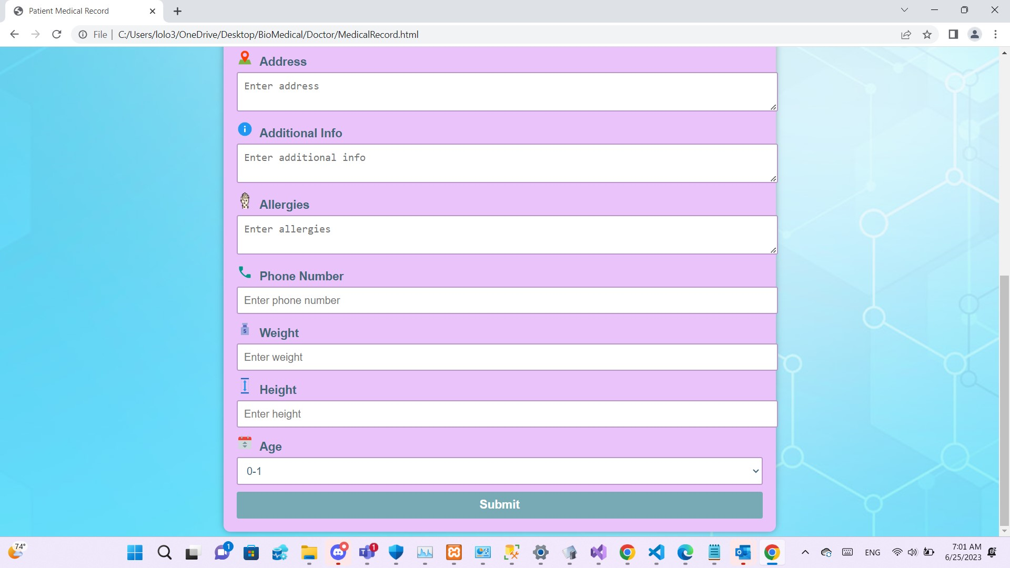
Pediatric Clinical System

Slide 12
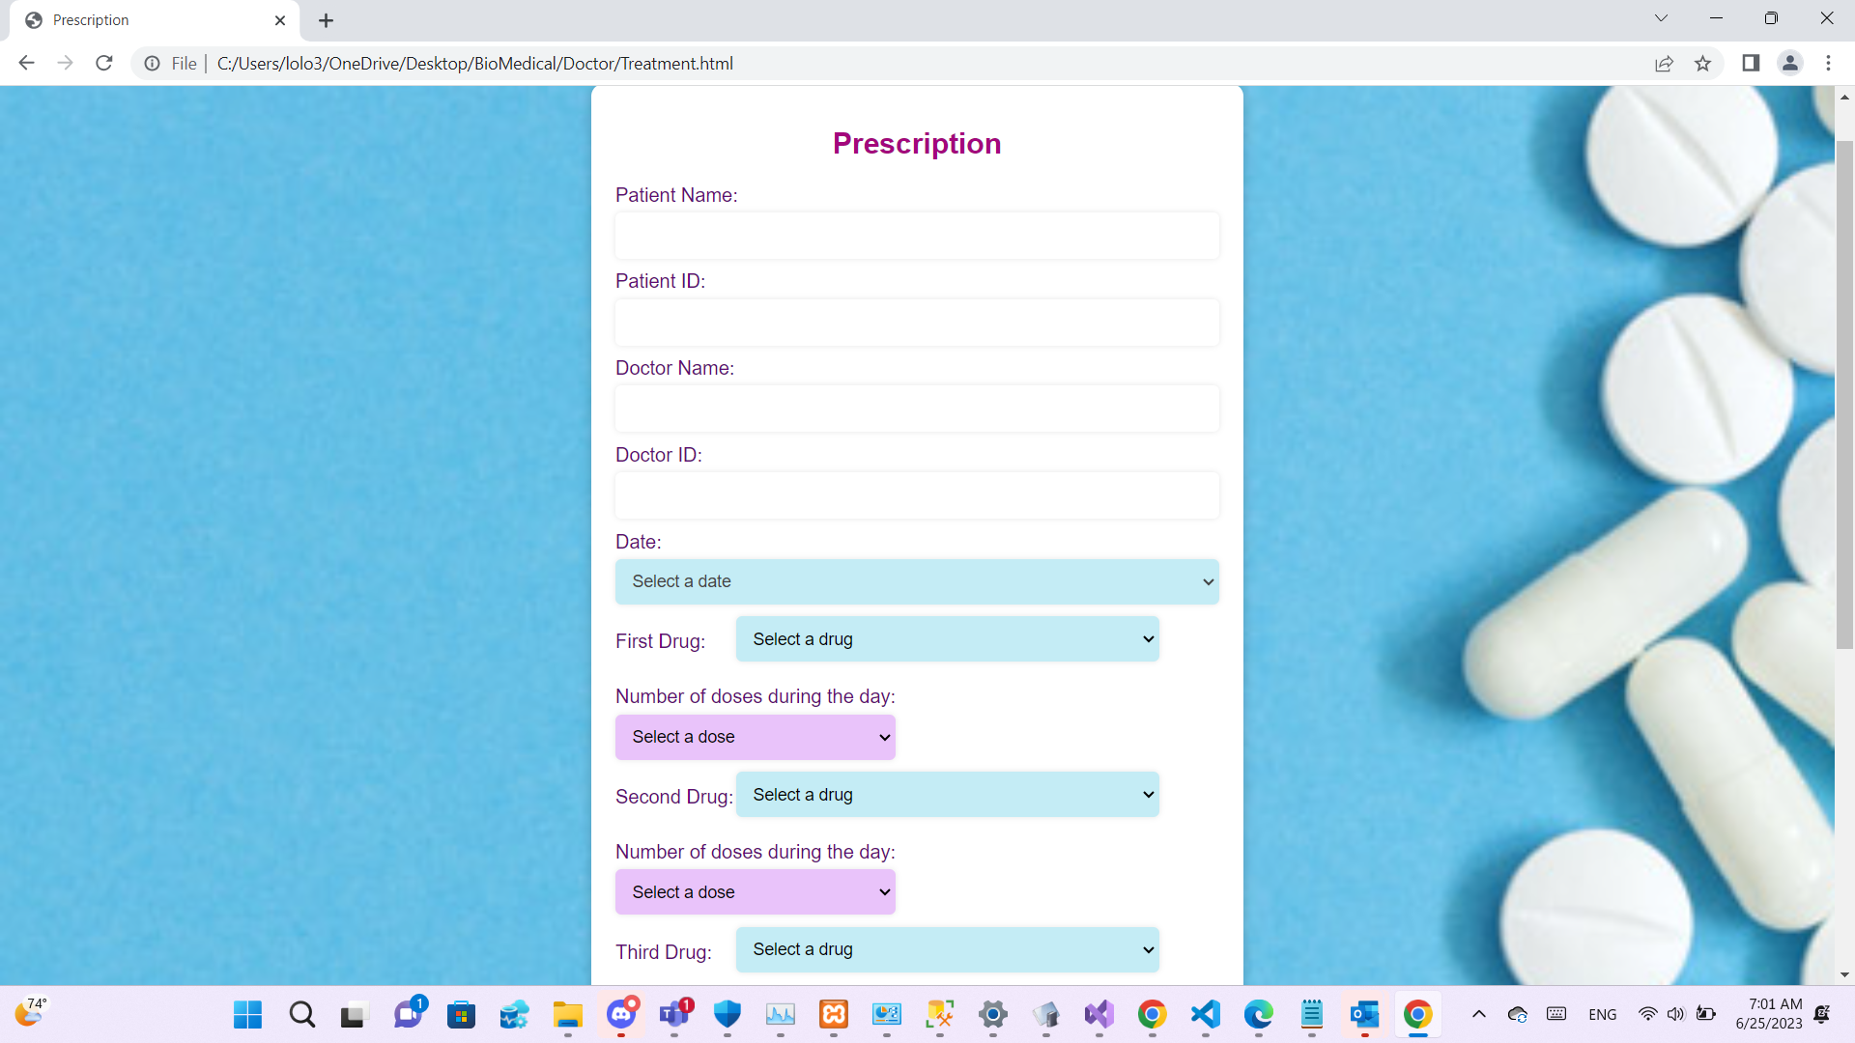
Pediatric Clinical System

Slide 13
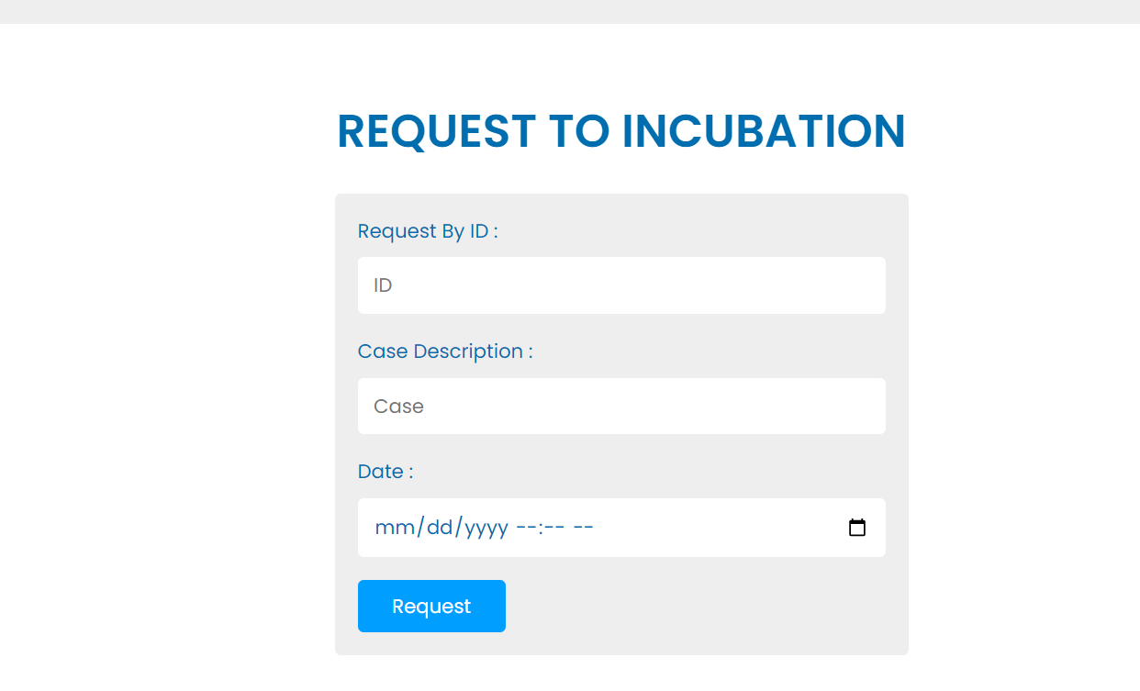
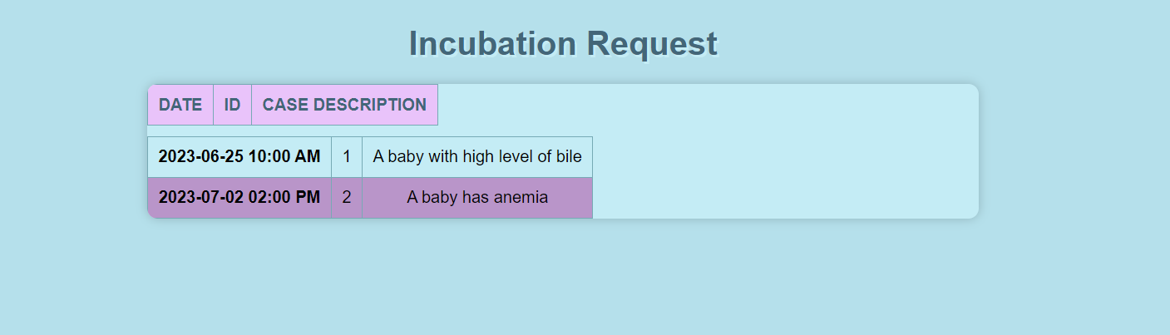
Incubation System

Slide 14
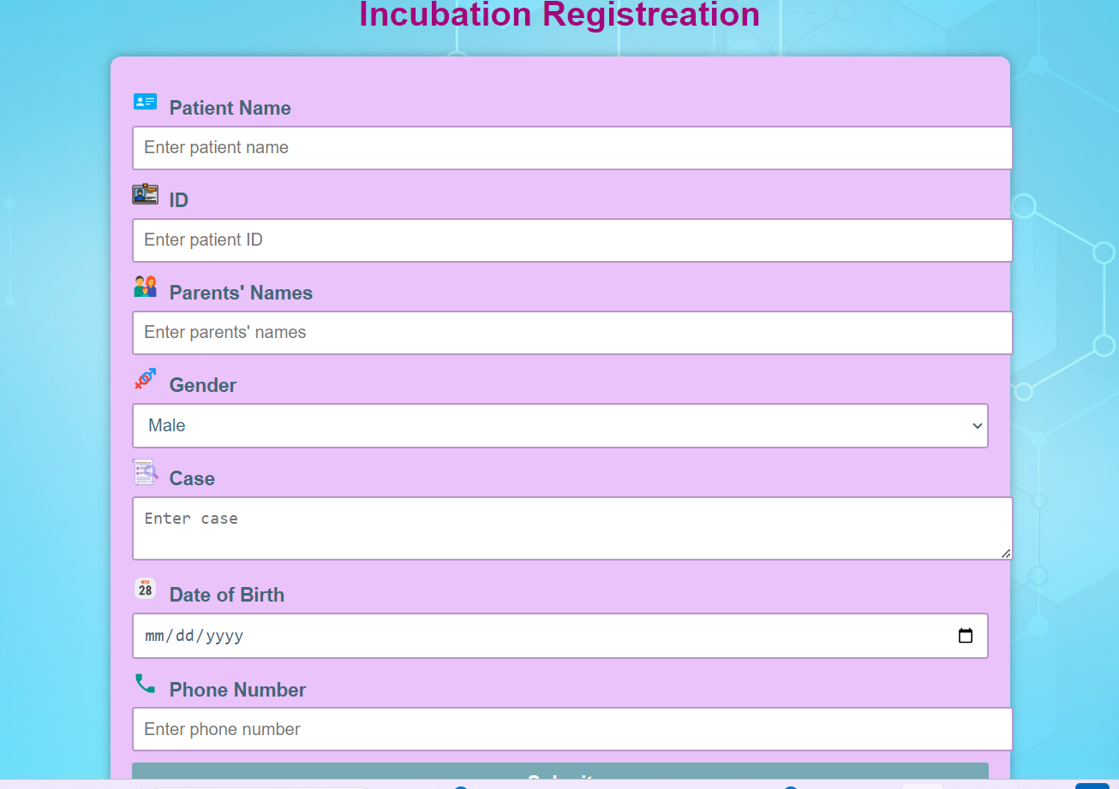
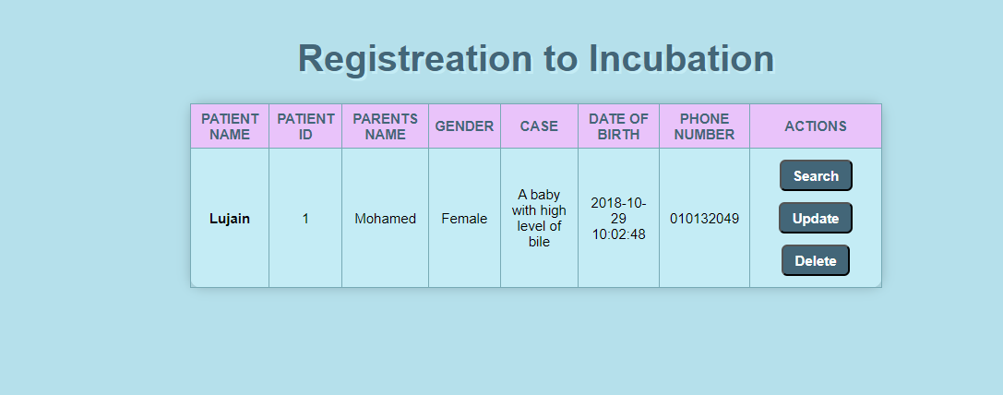
Incubation System

Slide 15
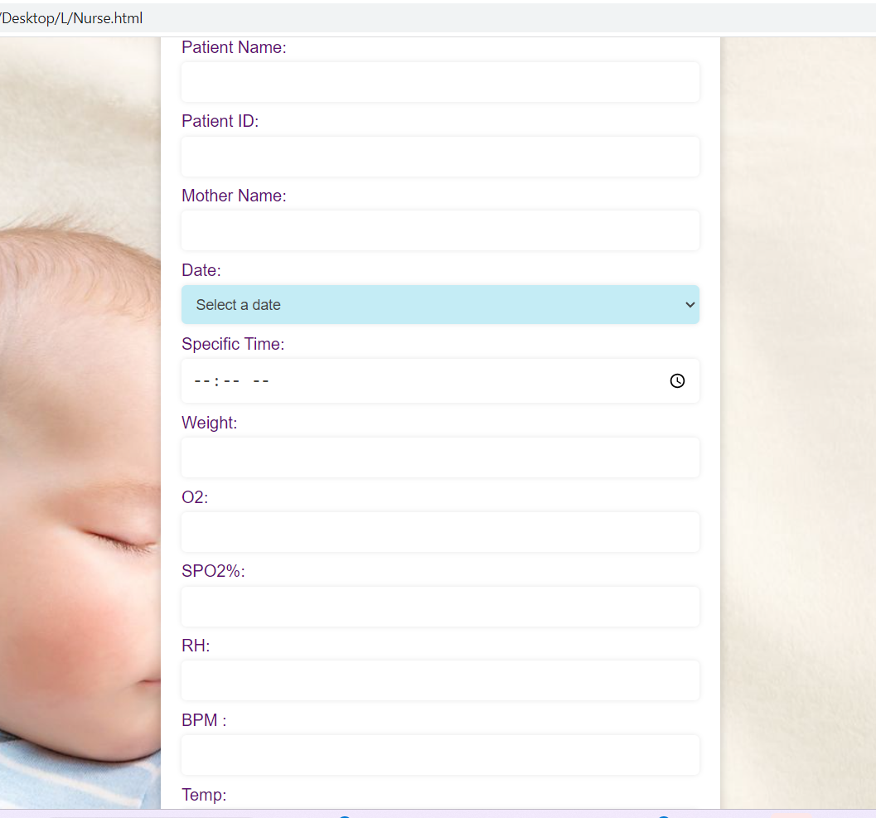
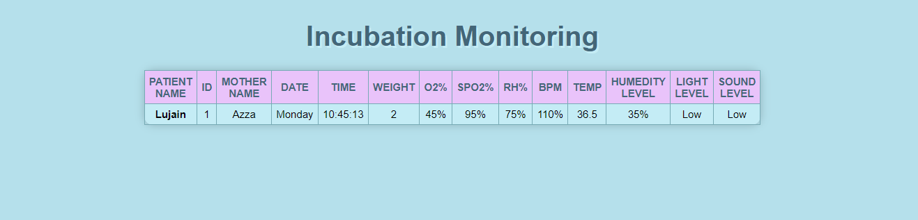
Incubation System

Slide 16


Incubation System future work
How to implement IoT:
IoT devices: sensors (humidity and temperature etc.
IoT platform: google cloud platform.
Connectivity: Wi-Fi or Bluetooth.
Analytics tools: google analytics.

Slide 17
Demo of the System
Drive link
https://drive.google.com/drive/folders/1kCvCclA4ZeNVnLINWaAHf3jmcAYcMat9?usp=sharing

Slide 18

Conclusion
Benefits of integrating a pediatric clinic system with an incubation system.
Transformation in patient care, clinic operations, and data management.
Future directions and potential advancements.

Slide 19
References
Pediatric Clinic Management Software. Daftra. (n.d.). https://www.daftra.com/en/pediatric-clinic/
https://www.pxtrack.tech/pediatric-clinic-electronic-medical-records-systems/. You are being redirected... (n.d.).

Slide 20






Our team
Lujian M.ELsaid
Mariam H.Shehata
Mary N.AbdelNour
Ranim M.Abbdlfattah
Ahmad Kh.Kamal
Michael A.William

Slide 21

Thank You

